Slide 1


Ferrous alloys
UNIVERSIDAD AUTÓNOMA DE NUEVO LEÓN
FACULTAD DE INGENIERÍA MECÁNICA Y ELÉCTRICA
Ana Paola Cerda Treviño
1798043
IAE
apcerda@live.com.mx
Professor: Dr. Krishnan Bindu
May 8th 2018, San Nicolás de los Garza, Nuevo León

Slide 2
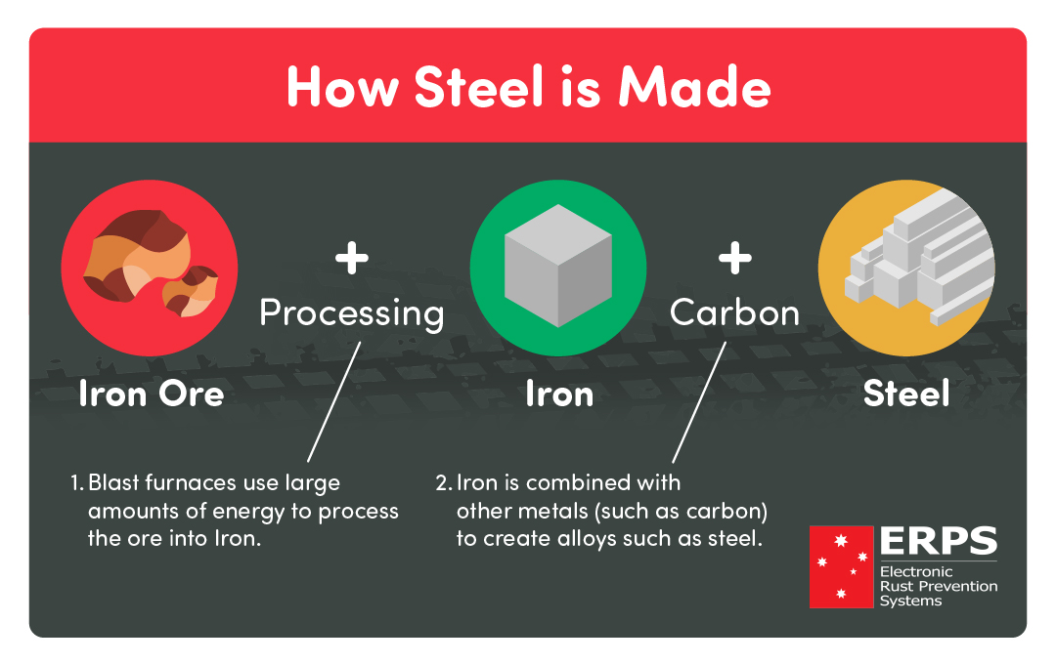
What is an alloy ?
An alloy is defined as any metal made by combining two or more metallic elements, including some traces of other non-metallic elements.

Slide 3
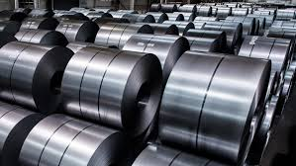
Steel containing alloys
Steel is an alloy made of iron and carbon containing less than 2% carbon and 1% manganese and small amounts of silicon, phosphorus, sulphur and oxygen. Steel is the world's most important engineering and construction material. It is used in every aspect of our lives; in cars and construction products, refrigerators and washing machines, cargo ships and surgical scalpels,etc.

Slide 4
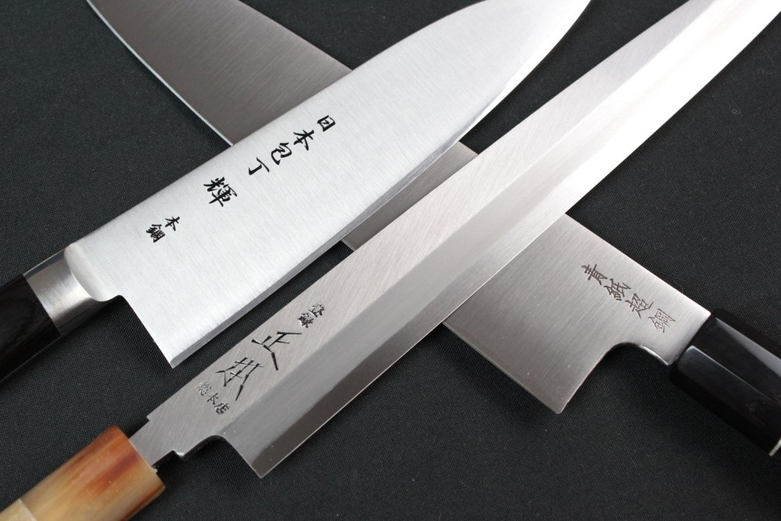
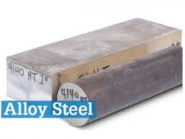
Steel is not a single product. There are more than 3,500 different grades of steel with many different physical, chemical, and environmental properties.
But it is mainly divided in four categories, depending on their amount of carbon:
Carbon Steels
Carbon steels contain trace amounts of alloying elements and account for 90% of total steel production.
Alloy Steels
Alloy steels contain alloying elements (e.g. manganese, silicon, nickel, titanium, copper, chromium, and aluminum) in varying proportions in order to manipulate the steel's properties, such as its hardenability, corrosion resistance, strength, formability, weldability or ductility.
Applications for alloys steel include pipelines, auto parts, transformers, power generators and electric motors.

Slide 5
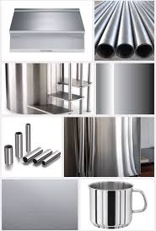
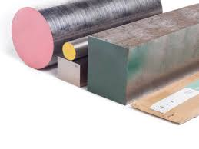
Stainless Steels
Stainless steels generally contain chromium as the main alloying element and are valued for high corrosion resistance. This is about 200 times more resistant to corrosion than mild steel. These steels can be divided into three groups based on their crystalline structure:
Austenitic: Austenitic steels are non-magnetic and non heat-treatable, and generally contain chromium, nickel and carbon. They form the largest portion of the global stainless steel market and are often used in food processing equipment, kitchen utensils, and piping.
Ferritic: Ferritic steels contain trace amounts of nickel, chromium, carbon, along with other alloying elements, such as molybdenum, aluminum or titanium. These magnetic steels cannot be hardened by heat treatment but can be strengthened by cold working.
Martensitic: Martensitic steels contain 11-17% chromium, less than 0.4% nickel, and up to 1.2% carbon. These magnetic and heat-treatable steels are used in knives, cutting tools, as well as dental and surgical equipment.
Tool Steels
Tool steels contain tungsten, molybdenum, cobalt and vanadium in varying quantities to increase heat resistance and durability, making them ideal for cutting and drilling equipment.

Slide 6
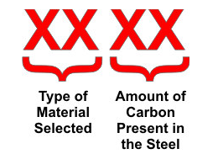
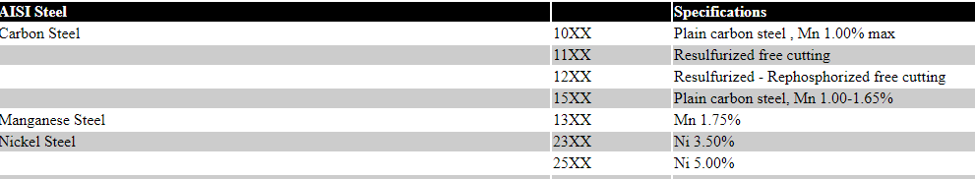
AISI CODE
AISI (American Iron and Steel Institute)
A four-digit number is usually given to the AISI alloy steels and carbon steels. The alloying element in the AISI specification is indicated by the first two digits and the amount of carbon is indicated by the last two digits.

Slide 7
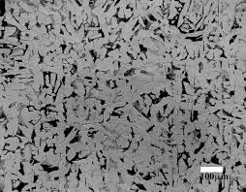
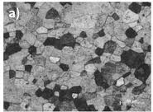
Microstructure
- Microstructure refers to the surface structure of materials such as thin foil that can be revealed under magnification higher than 25×. A material’s microstructure can be classified into the following:
Composite
Metallic
Ceramic
Polymeric
This can immensely affect properties that determine the application of materials like:
Corrosion
Wear resistance
Hardness
Ductility
Toughness

Slide 8

irons
There are two major types of iron produced: wrought iron and cast iron.
Wrought iron
The first type of iron produced and worked by blacksmiths was wrought iron. It is virtually pure elemental iron (Fe) that is heated in a furnace before being wrought (worked) with hammers on an anvil. Hammering iron expels most of the slag from the material and welds the iron particles together.

Slide 9
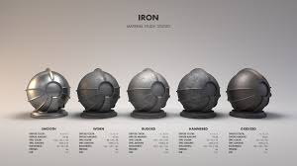
Cast irons
Cast iron is a family of metals produced by smelting metal, and then pouring it into a mold. The primary difference in production between wrought iron and cast iron is that cast iron is not worked with hammers and tools. There are also differences in composition—cast iron contains 2–4% carbon and other alloys, and 1–3% of silicon, which improves the casting performance of the molten metal.

Slide 10
Mechanical properties of cast irons
A few common mechanical properties for cast iron include:
Hardness – material's resistance to abrasion and indentation
Toughness – material’s ability to absorb energy
Ductility – material's ability to deform without fracture
Elasticity – material's ability to return to its original dimensions after it has been deformed
Malleability – material's ability to deform under compression without rupturing
Tensile strength – the greatest longitudinal stress a material can bear without tearing apart
Fatigue strength – the highest stress that a material can withstand for a given number of cycles without breaking

Slide 11
Gray iron
Gray iron is characterized by the flake shape of the graphite molecules in the metal. When the metal is fractured, it happens along the graphite flakes, which gives it the gray color on the fractured metal's surface,hense the name gray iron.
Gray iron is not as ductile as other forms of cast iron and its tensile strength is also lower. However, it is a better thermal conductor and has a higher level of vibration damping it is also easier to machine than other cast irons.

Slide 12
White iron
With the right carbon content and a high cooling rate, carbon atoms combine with iron to form iron carbide. This means that there are little to no free graphite molecules in the solidified material.
The cementite microcrystalline structure is hard and brittle with a high compressive strength and good wear resistance.
The addition of chromium and nickel alloys gives this product excellent properties for low impact, sliding abrasion applications.

Slide 13
Malleable iron
White iron can be further processed into malleable iron through a process of heat treatment. An extended program of heating and cooling, results in the breakdown of the iron carbide molecules, releasing free graphite molecules into the iron. Different cooling rates, and the addition of alloys, produces a malleable iron with a microcrystalline structure.

Slide 14
Ductile iron
Ductile iron, or nodular iron, obtains its special properties through the addition of magnesium into the alloy. The presence of magnesium causes the graphite to form in a spheroid shape as opposed to the flakes of gray iron. Different grades of ductile iron can formed by manipulating the microcrystalline structure, this can be achieved through the casting process, or through heat treatment, as a downstream processing step.

Slide 15
Compacted graphite iron
Compacted graphite iron has a graphite structure and associated properties that are a mix of gray and white iron. The microcrystalline structure is formed around blunt flakes of graphite which are interconnected.
Compacted graphite iron has a higher tensile strength and improved ductility compared to gray iron. The microcrystalline structure and properties can be adjusted through heat treatment or the addition of other alloys.

Slide 16
Conclusion
In conclusion, Steel and iron are both very important materials for engineering, and this is due to their unique properties, even so they cannot be used in every field or to build just anything, they are mostly used for building very strong and stress resistant products. But in the end this ultimately depends on the mission assigned to them, which is why alloys are very useful, so that they can have whatever properties they may need.

Slide 17
Bibliography
Cited websites: W. (n.d.). ABOUT STEEL. Retrieved from https://www.worldsteel.org/about-steel.html AZoM, W. B. (2014, August 08). SAE/AISI Carbon Steel Naming Conventions. Retrieved from https://www.azom.com/article.aspx?ArticleID=6151 Introduction to Cast Iron: History, Properties, and Uses. (n.d.). Retrieved from http://www.reliance-foundry.com/castings/cast-iron#gref Cited books:
Street, Arthur & Alexander, W.O. 1944. Metals in the Service of Man. 11th Edition (1998).

